Slide 1

“Serial 2’s Complementor with a Shift Register and a flip–flop.”
END SEMESTER ASSESSMENT (ESA)
B.TECH. (CSE) III SEMESTER
DIGITAL DESIGN & COMPUTER ORGANIZATION LABORATORY
UE18CS206
Project Number: 10
Project Batch Number: C14
1. KIRAN B S PES2UG19CS186
2. KIRAN M KANNUR PES2UG19CS187
3. KIRTAN T S PES2UG19CS188
4. KODURU BHARATH SUBBA REDDY PES2UG19CS189

Slide 2
ABSTRACT OF THE PROJECT:
As we see in the diagram below there is a serial input and serial output connected to the shift register in the circuit diagram. The clock of the register is connected to the clock signal of the D Flip-Flop. The serial output is being fed back to the input of the OR gate and it’s output P is fed to the input of the Flip-Flop and the output of the FlipFlop is fed to the input of the input of the OR gate. We also have a reset signal to the Flip-Flop which is 0 initially and whenever the reset signal is 1 the value are resetted. The output of the Flip-Flop is also fed to the input of the XNOR gate and the other input is from the serial output. And at last the output of the XNOR is the the input of the Shift Register and is also known as the Serial Input which eventually leads to the shift in the 2’s compliment of the shift register and the preocess reprats.
Flip flop and shift registers triggered at same frequency. Thus, both produce the outputs at the same time.

Slide 3
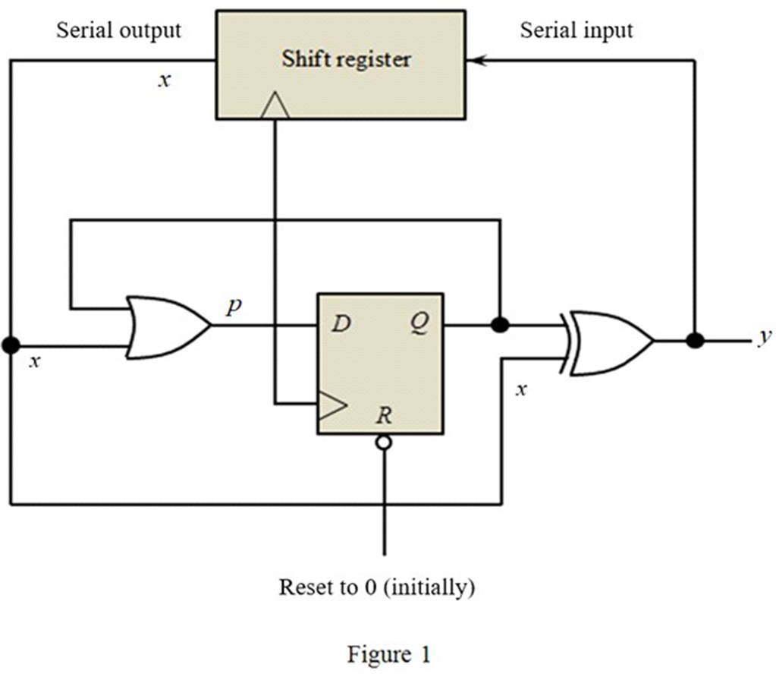
CIRCUIT DIAGRAM

Slide 4
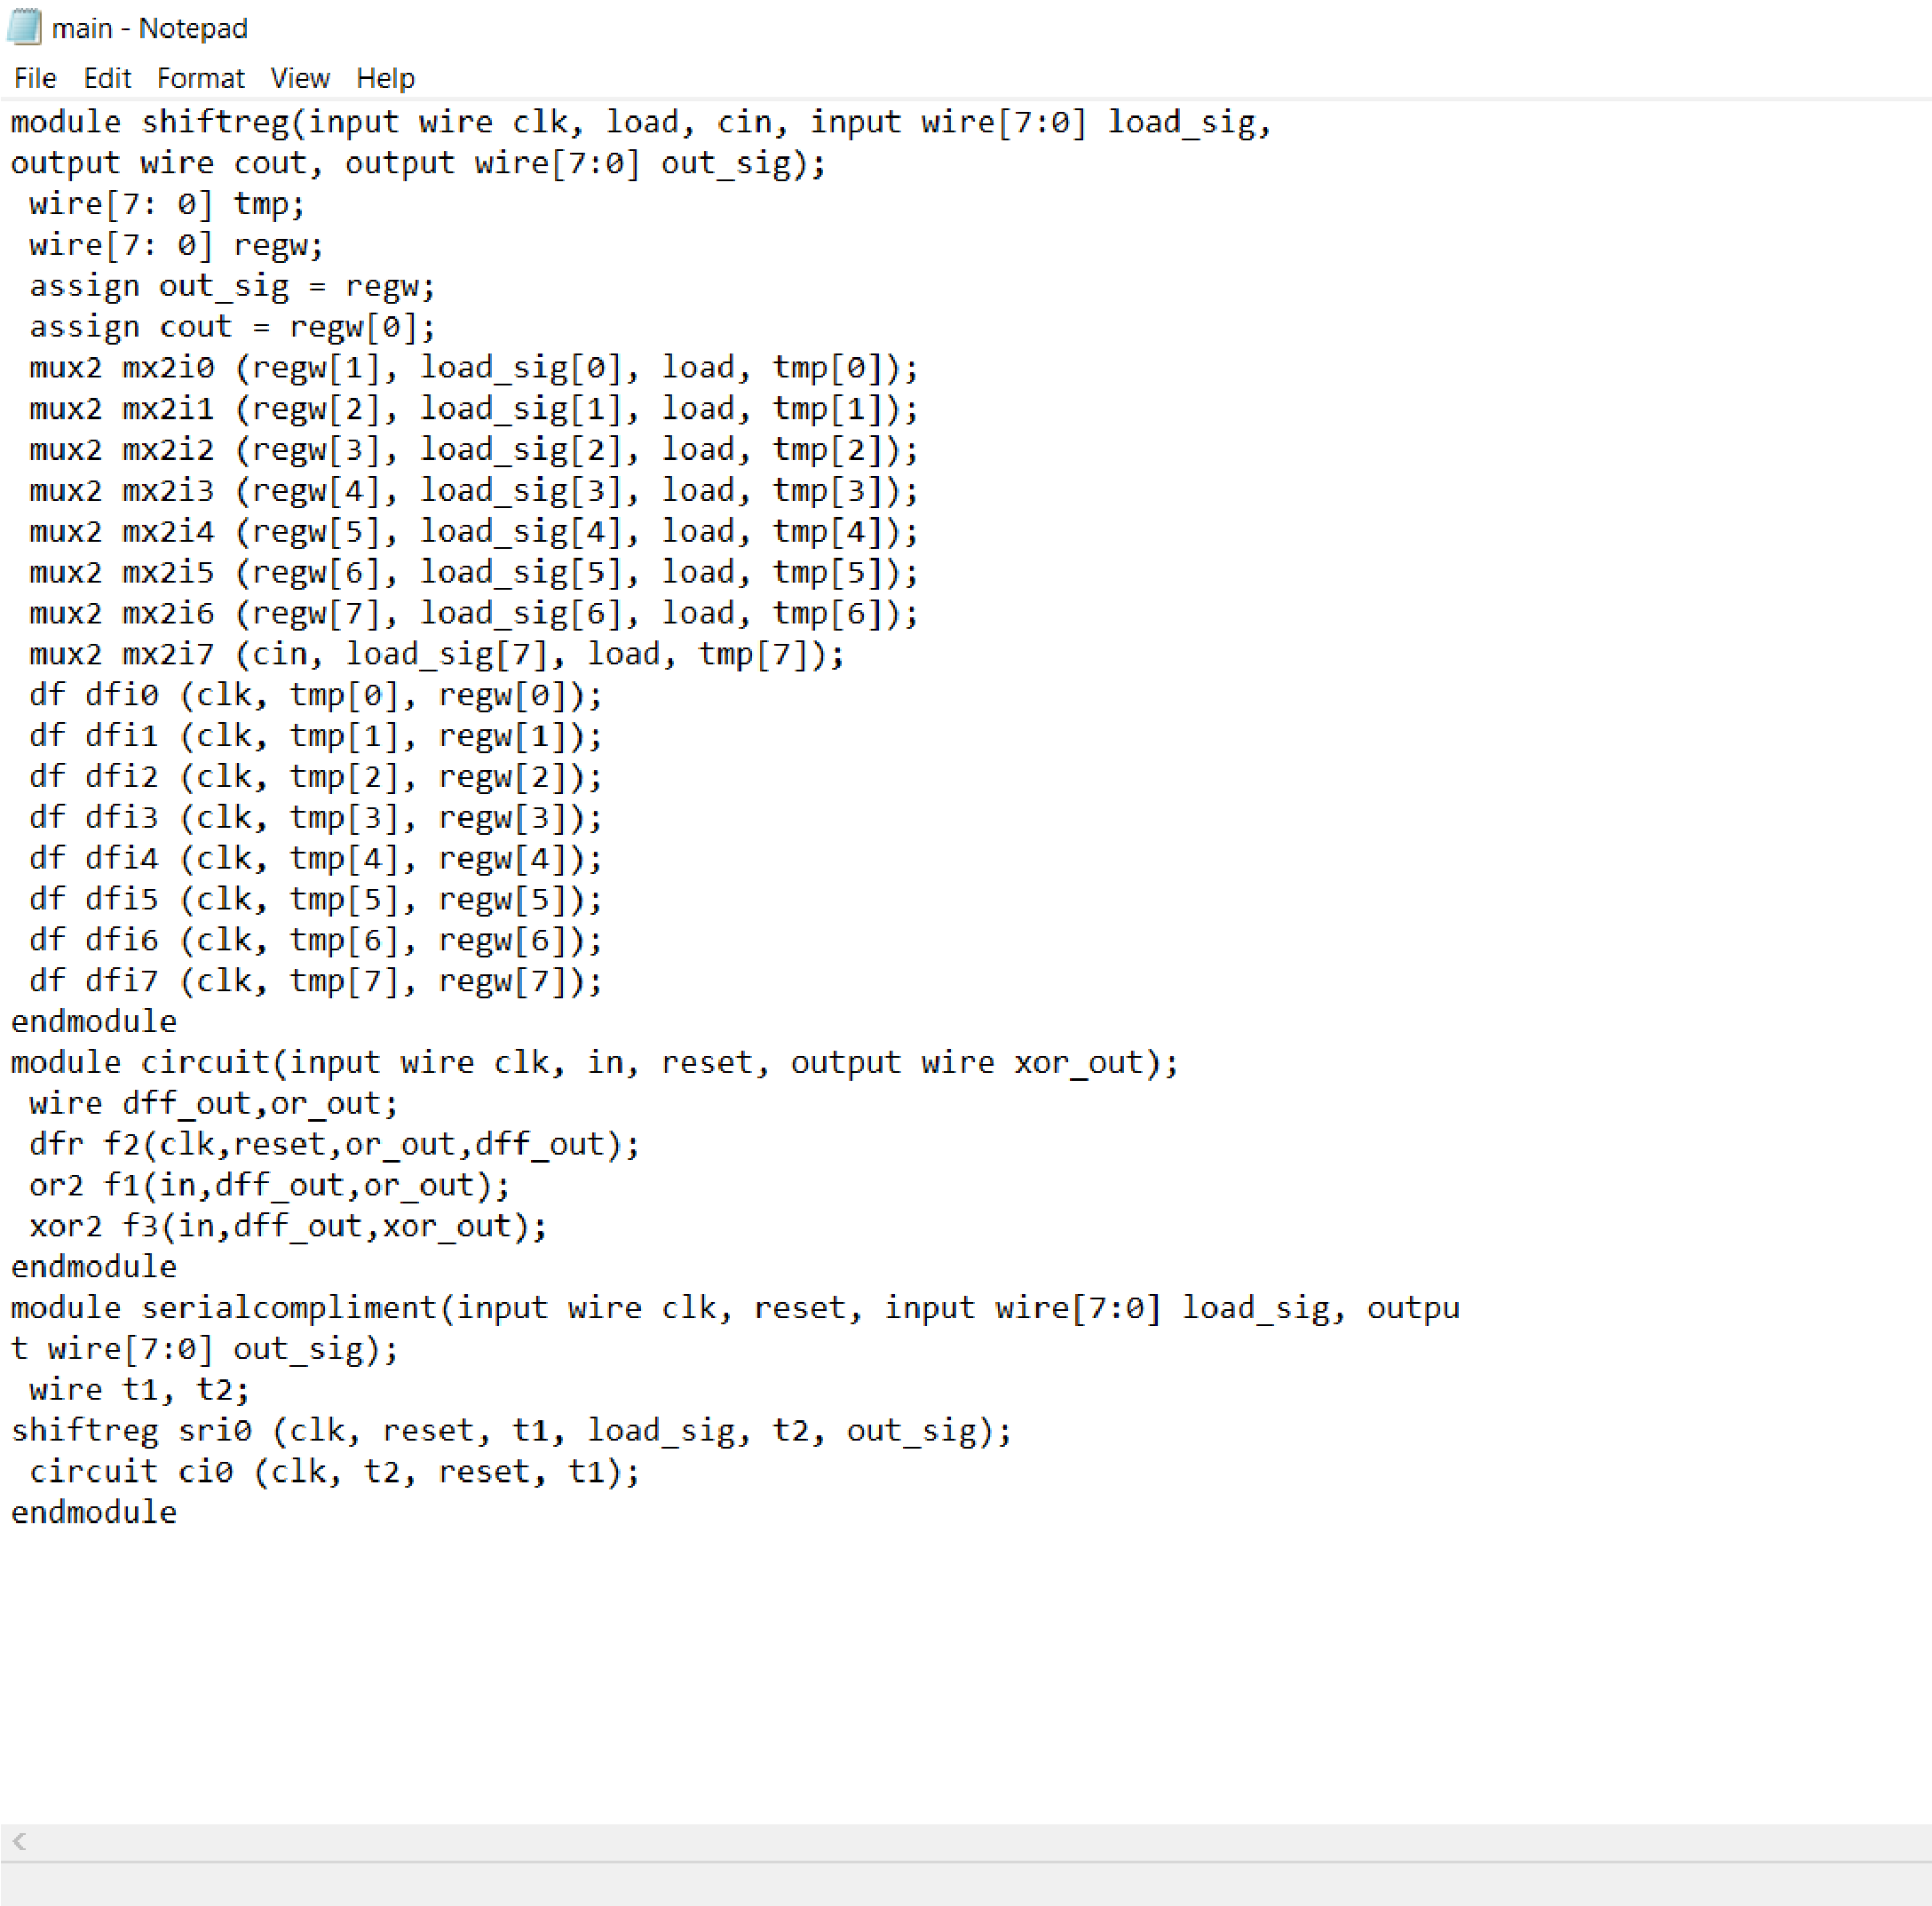
VERILOG CODE USED :

Slide 5
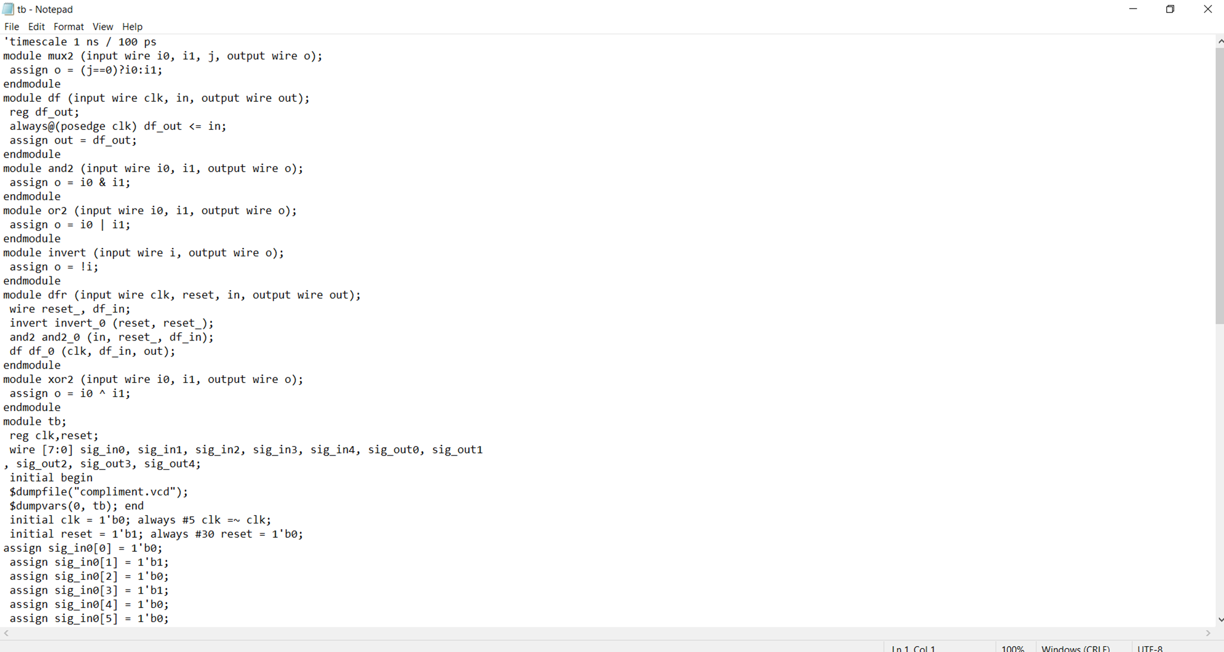
TEST BENCH FILE

Slide 6
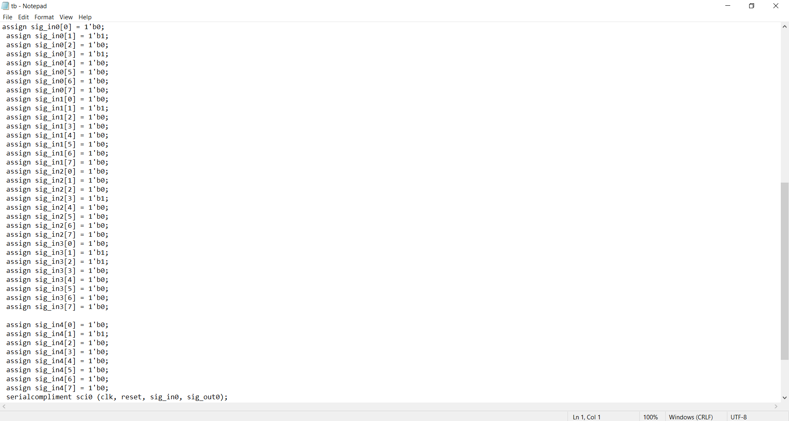

Slide 7
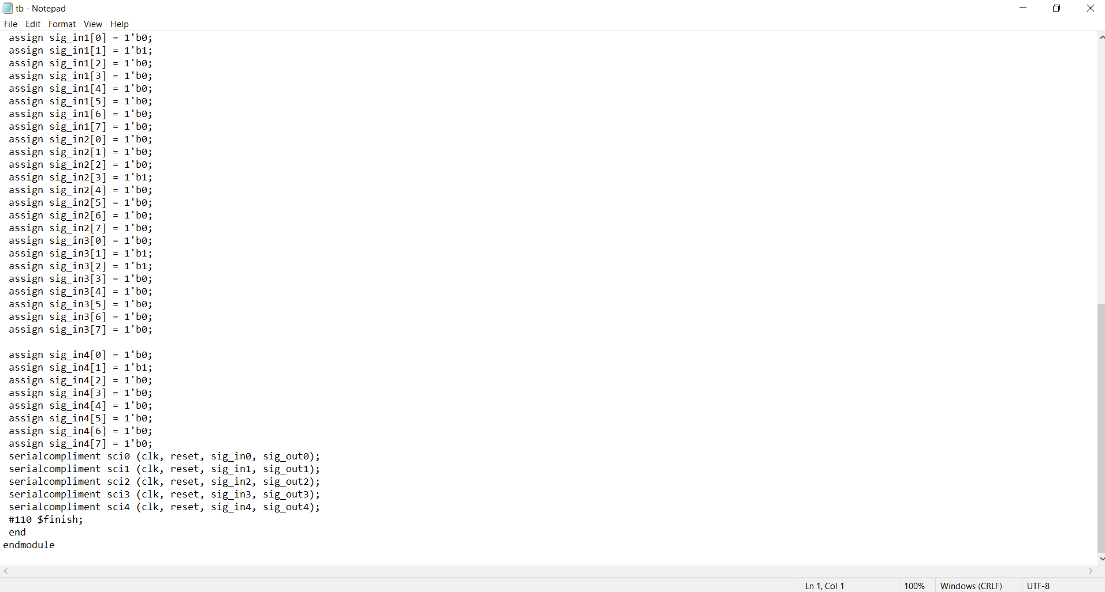

Slide 8
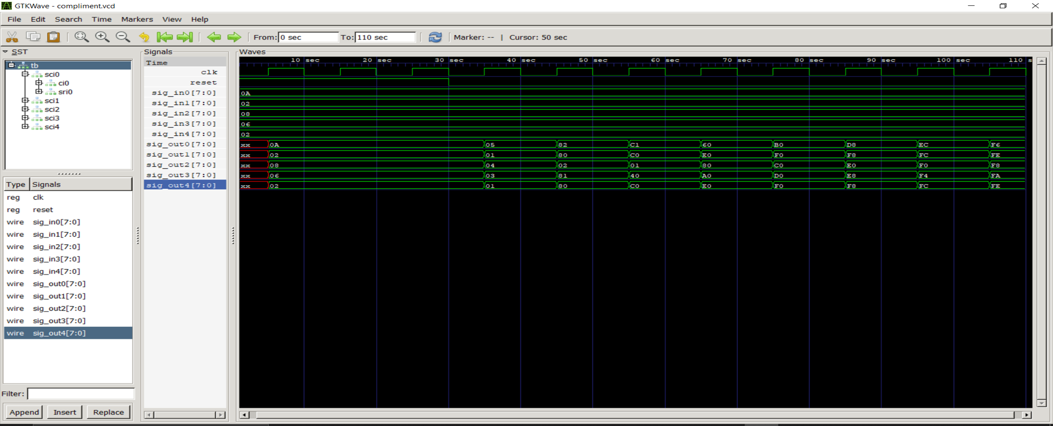
SCREENSHOTS

